Slide 1
MATLAB ASSIGNMENT 3
GROUP 16

Slide 2
GROUP 16 MEMBERS
NO. | STUDENT NAME | REG. NO. | COURSE | SEX | GITHUB LINK
1 | KABWERU ANDREW | BU/UG/2024/5057 | WAR | M | https://github.com/kabweruandrew39-alt/Andrew.git
2 | CHEMONGES MIKIRAR | BU/UP/2024/1005 | WAR | M | https://github.com/Chemonges-mikirar/Chemonges
3 | NAGASHA RITTA | BU/UG/2024/5055 | AMI | F | https://github.com/Nagasharitah/Nagasha-Ritta.git
4 | DIKITAL JOHN | BU/UP/2024/1125 | WAR | M | https://github.com/JOHNDIKITAL/johndikitalmatlab.git
5 | SANYU JOY | BU/UP/2024/5348 | MEB | F | https://github.com/joysanyu22-cell/SANYU-JOY.git
6 | OULE SADOCK | BU/UP/2024/0844 | AMI | M | https://github.com/oulesadock25/Oule-Sadock-.git
7 | WANGUSI DAVID | BU/UP/2024/5350 | MEB | M | https://github.com/wangusid22/WANGUSI-DAVID.git
8 | SEBATIKA COLLINE | BU/UP/2024/0845 | AMI | M | https://github.com/SebyatikaColline/Sebyatika-Colline.git
9 | ATYANG MILDRED | BU/UP/2024/1019 | WAR | F | https://github.com/mildredmoreen/ATYANG-MILDRED-.git
10 | KITUTU LEONARD | BU/UP/2024/1035 | WAR | M | https://github.com/leonardkitutu1-hue/leonard-kitutu.git

Slide 3
INTRODUCTION
The above presentation involves a systematic approach to numerical analysis methods such as Secant and Newton Raphson method and analytical methods for solving ODEs such as Runge Kutta and Euler data for question 1 & 2
Steps involved include:
Problem identification
Mathematical formulation
Algorithm development
Implementation in MATLAB
Validation and comparison
Application to real world problems

Slide 4
QUESTION ONE
Utilizing knowledge of algorithm and control structures and modules 1 to 4 to do numerical approximation and finding the solutions to functions by newtons Raphson and secant methods
STEPS FOLLOWED
Choosing type of function
Drawing the flow chart
Reading the initial approximations and other inputs
Finding the exact or true root
Looping through each Iteration
Printing the root XI
Updating the variables
Using the Newton Raphson Method
Printing the time of computation
Plotting the graph
Results

Slide 5
Step 1
As group 16 we chose implementation of non linear functions

Slide 6
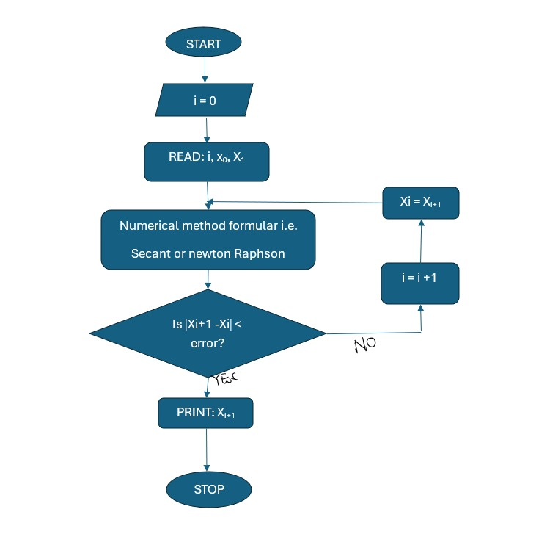
Step 2

Slide 7
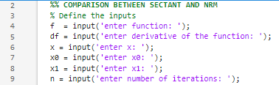

Step 3
Step 4

Slide 8
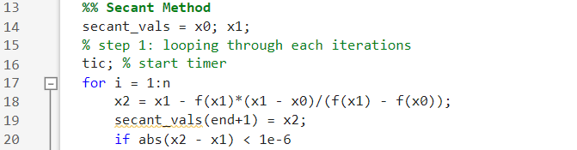
Step 5
Step 6

Slide 9

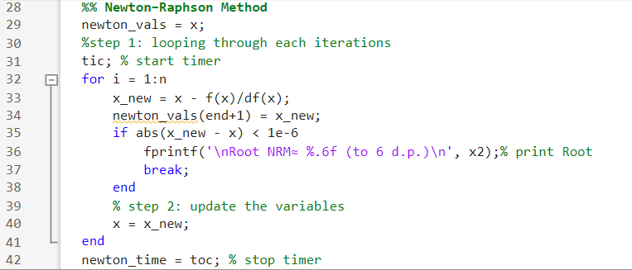
Step 7
Step 8

Slide 10

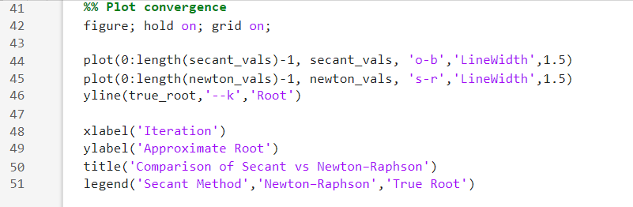
Step 9
Step 10

Slide 11
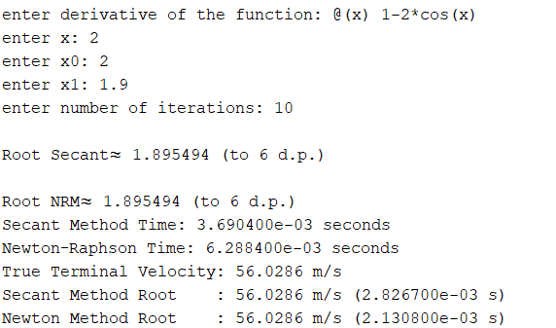
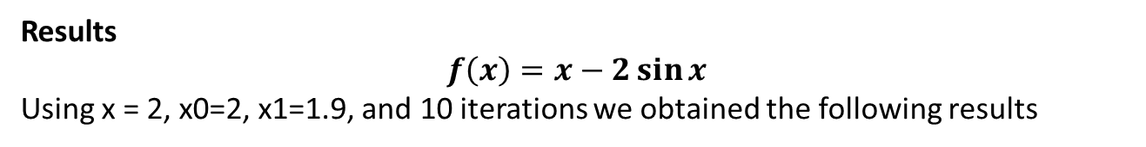
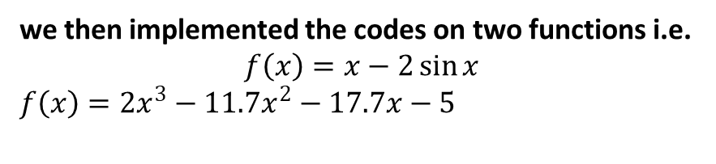
Step 11
we then implemented the codes on two functions i.e.
$$f\left(x\right)=x−2\sin{x}$$
$f\left(x\right)=2x^{3}−{11.7x}^{2}−17.7x−5$
Results
$$f\left(x\right)=x−2\sin{x}$$
Using x = 2, x0=2, x1=1.9, and 10 iterations we obtained the following results

Slide 12
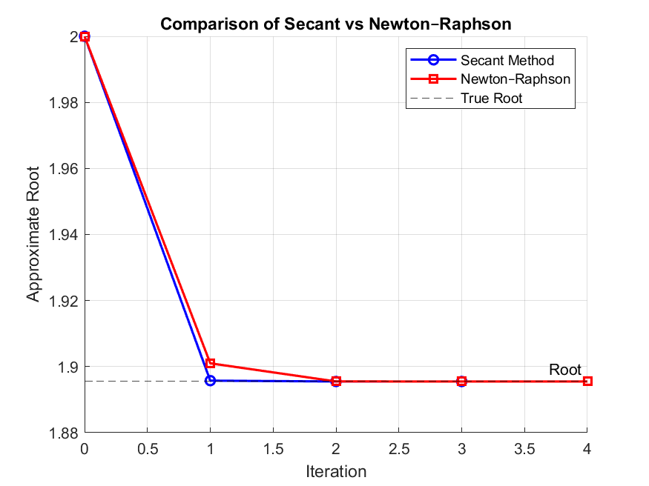

Slide 13
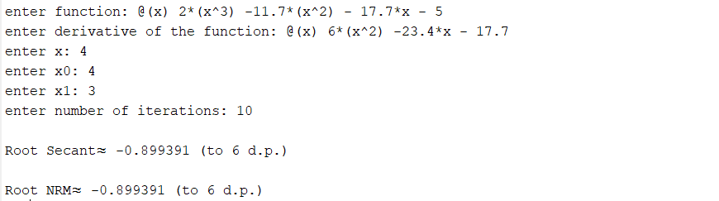
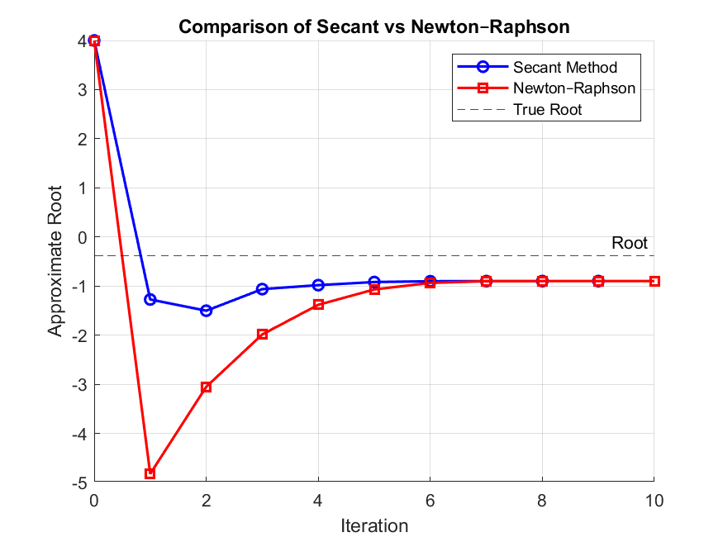

Slide 14
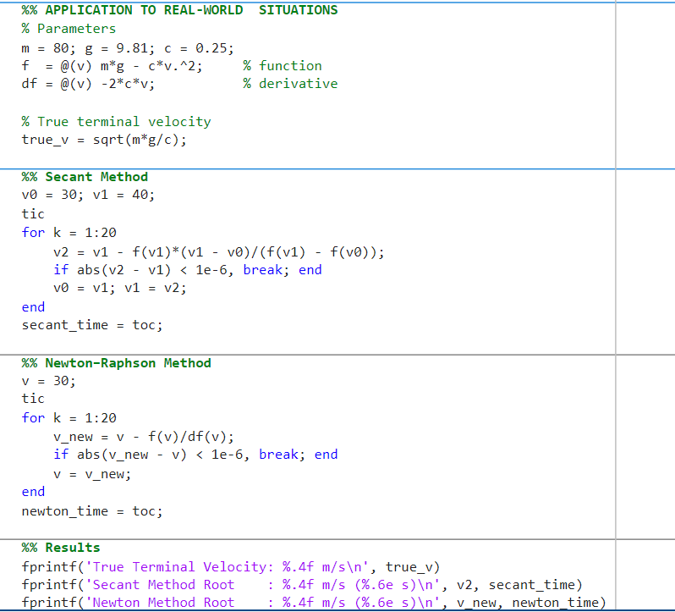
Application in a real world problem
Applied it to real world problem of finding terminal velocity (v) of particles with mass =80, g=9.81, c=0.25

Slide 15
The Outcome

Slide 16
QUESTION TWO
Using the knowledge of algorithm development, control structures, models one to four to solve the differential equations numerically while using methods such as Euler, Runge Kutta
Step 1: choosing type of functions
Step 2: flowcharts:
Step 3: reading the initial approximations and other inputs
Step 4: computing the exact value
Step 5: for Euler
Step 6: for Runge Kutta
Step 7: displaying computation time
Step 8: displaying results in a table
Step 9: plotting
RESULTS

Slide 17
Step 1
We the group 16 members decided to choose implementations on first order differential equations relating variable y with time t

Slide 18
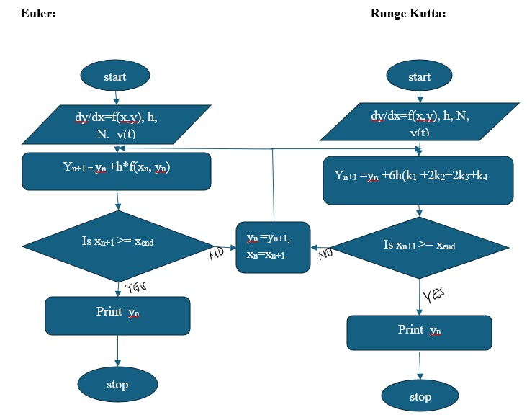
Step 2

Slide 19
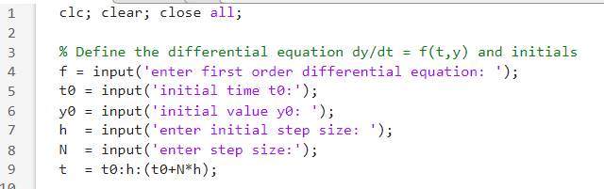
Step 3
Step 4
Using the code below we computed the exact value but note that the exact value of each function is found differently
Step 5

Slide 20
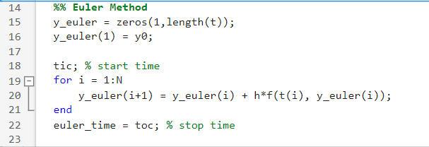
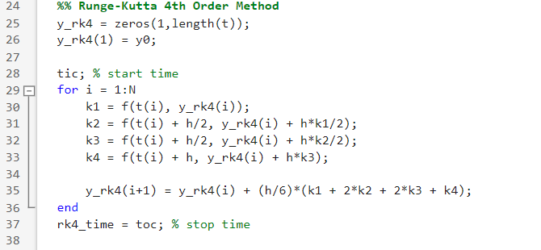
Step 6

Slide 21


Step 7
Step 8
Step 9
Plotting

Slide 22
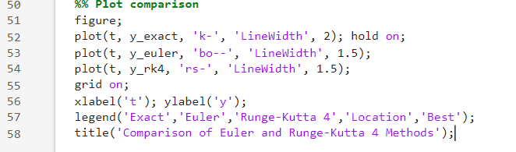

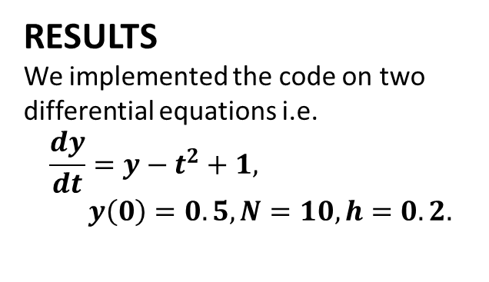
RESULTS
We implemented the code on two differential equations i.e.
$$\frac{dy}{dt}=y−t^{2}+1, y\left(0\right)=0.5, N=10, h=0.2.$$

Slide 23
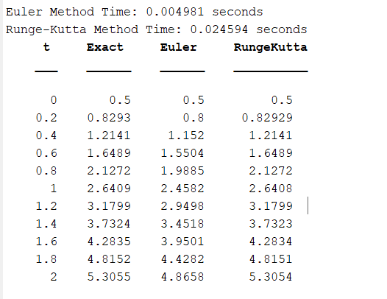
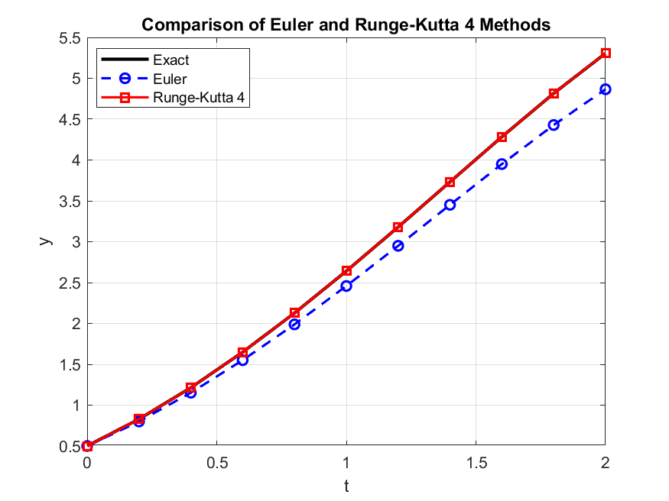

Slide 24

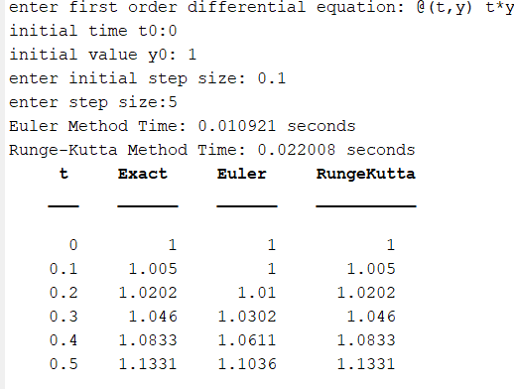
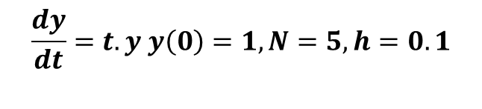
$$\frac{dy}{dt}=t.y y\left(0\right)=1,N=5,h=0.1$$

Slide 25
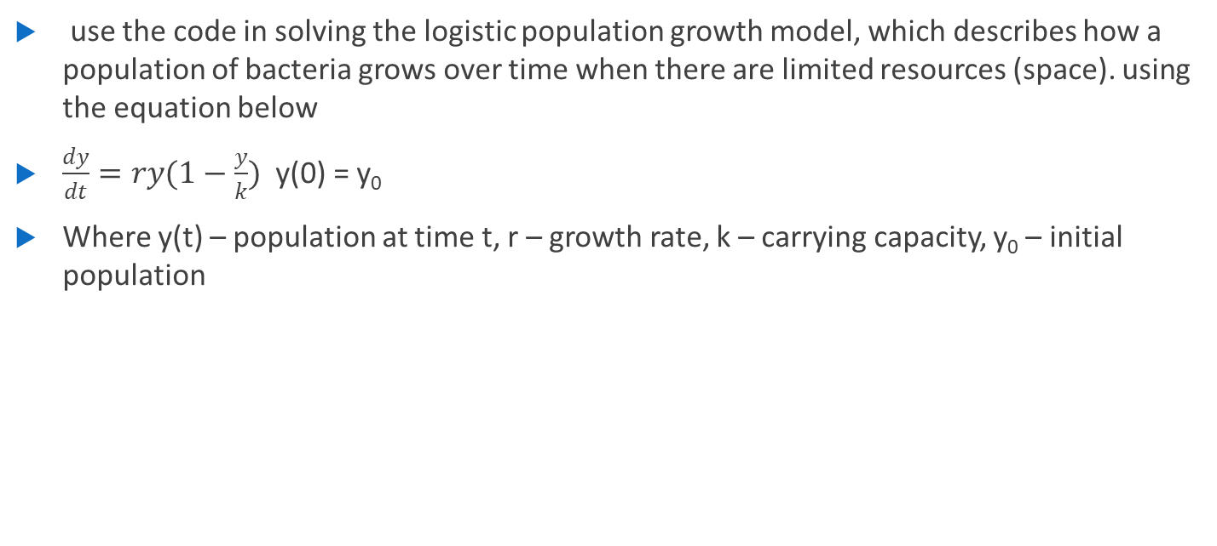
Application to a real world problem
use the code in solving the logistic population growth model, which describes how a population of bacteria grows over time when there are limited resources (space). using the equation below
$\frac{dy}{dt}=ry(1−\frac{y}{k})$ y(0) = y₀
Where y(t) – population at time t, r – growth rate, k – carrying capacity, y₀ – initial population

Slide 26
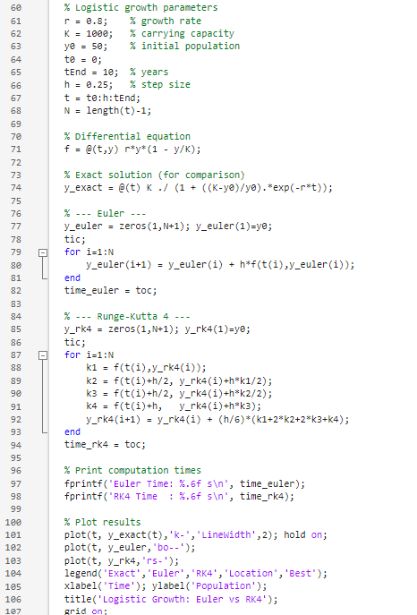
Code

Slide 27


Slide 28
Conclusion
In this study, numerical approximation methods were successfully implemented for finding roots and differential equation solving. The newton Raphson and secant methods provided accurate root estimation, while Euler and Runge Kutta methods gave approximate solutions to first order differential equations. The results show that higher order methods such as Runge Kutta provide more accurate answers compared to simpler methods like Euler, the overall assignment demonstrates the effectiveness of numerical techniques in solving in solving real world problems where analysis is difficult o impossible to obtain
THANK YOU

